Slide 1
SplitSmart Project
BY: Nidhi Patel, Elishbah, Pamela, Ahmed Alfaris, Zan

Slide 2
Scope
We will be testing the overall look and functionality of the SplitSmart.
The table should be presented neatly and the inputs should line up creating a clean and organized look.
All entries will be checked for validation and ensure that they are the correct data type if necessary.
Each valid entry should be entered and should go to the correct spot and align with the other inputs.

Slide 3
Major software functions
Our team has limited time to complete this project as well as additional commitments besides it. As each team member is busy, setting a schedule to work together and give updates on a time constraint is difficult.
The majority of the team's programmers lack the necessary web development knowledge. As a result, additional work is needed to learn and create a usable product.

Slide 4
Management and technical constraints
Developers - Utilize version control features in Git, communicate with other contributors how code functions, talk to each other..
Quality Assurance - Apply industry-developed QA tactics to avoid software bugs, routinely seek to clarify the development intentions of developers, scheduling the responsibilities of themselves and others
Client - Help the contributors to build a complete, comprehensive model of how the user should interact with the final product

Slide 5
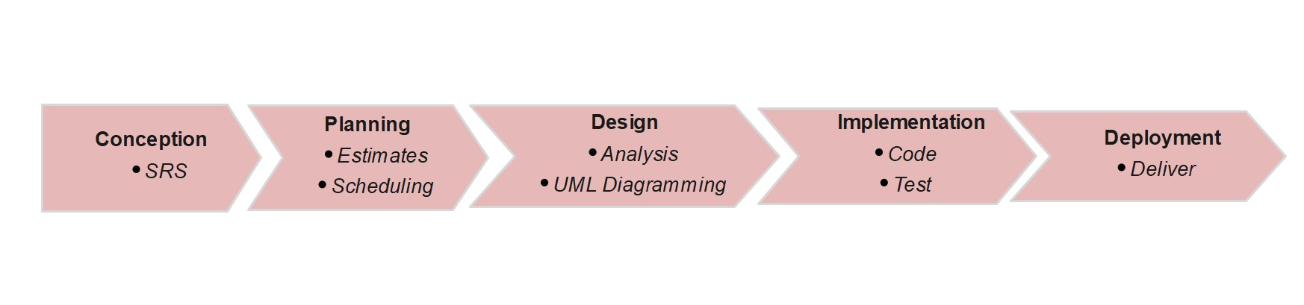
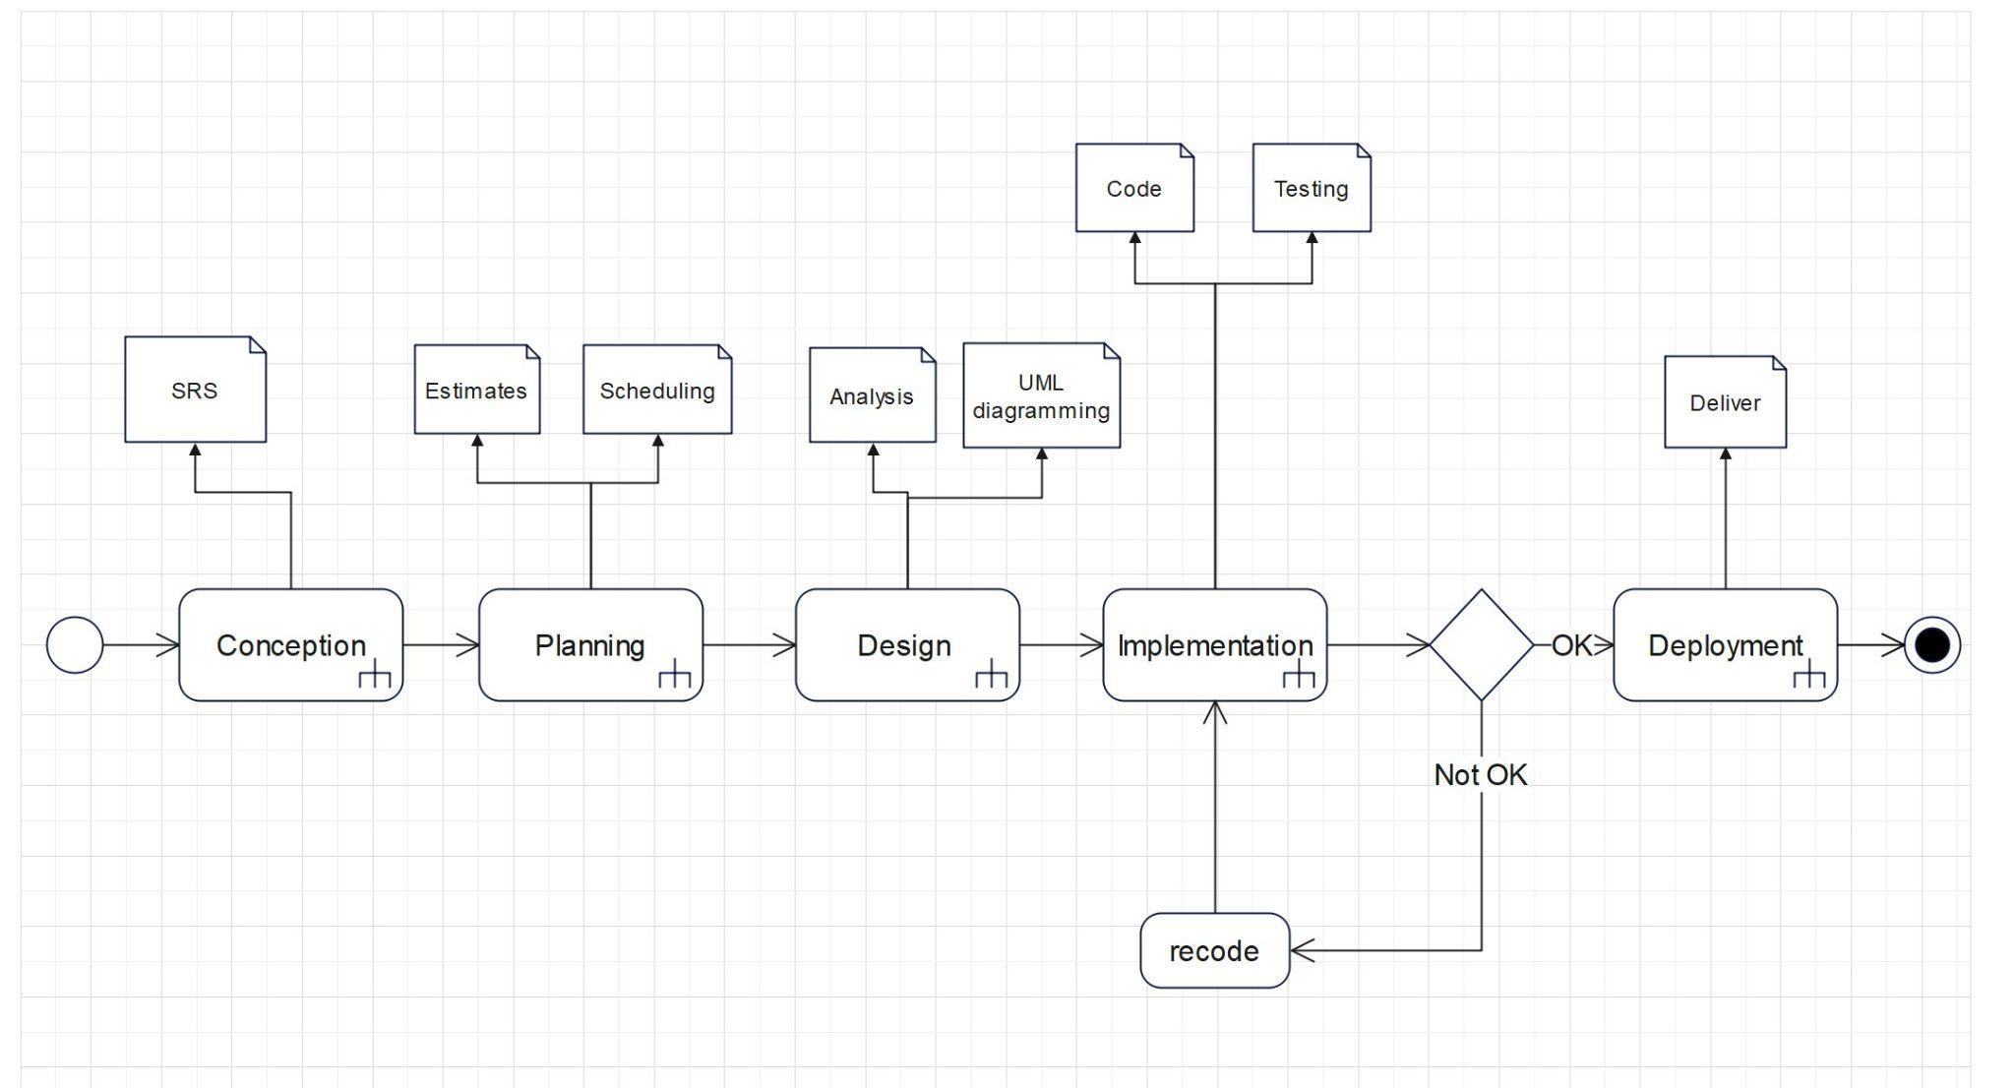
Project Schedule

Slide 6
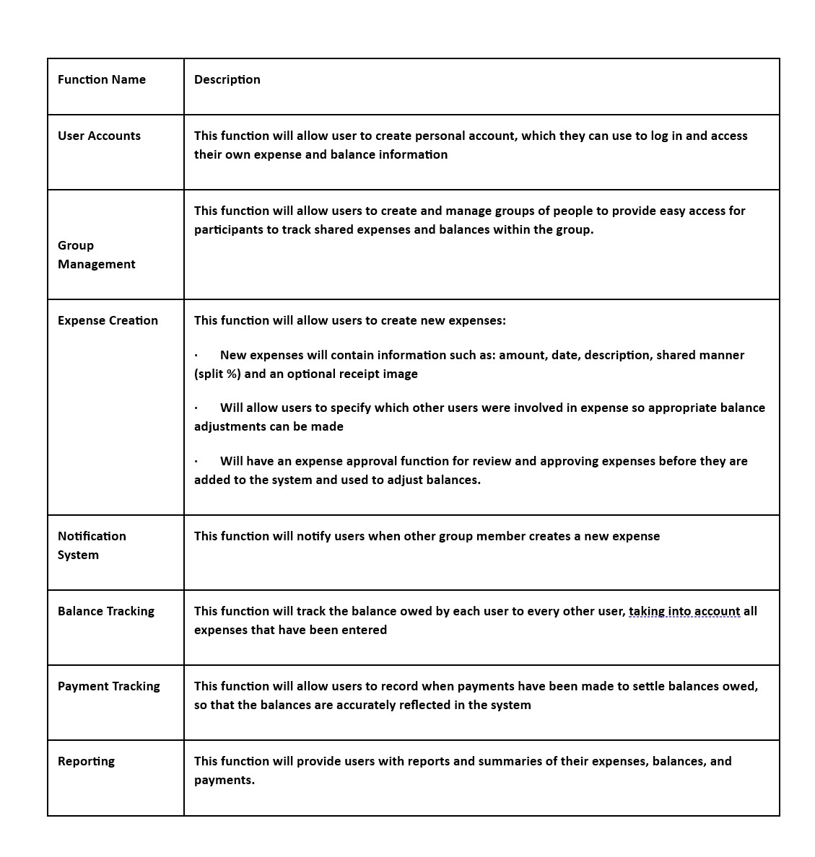
Functional Composition
User Functions

Slide 7
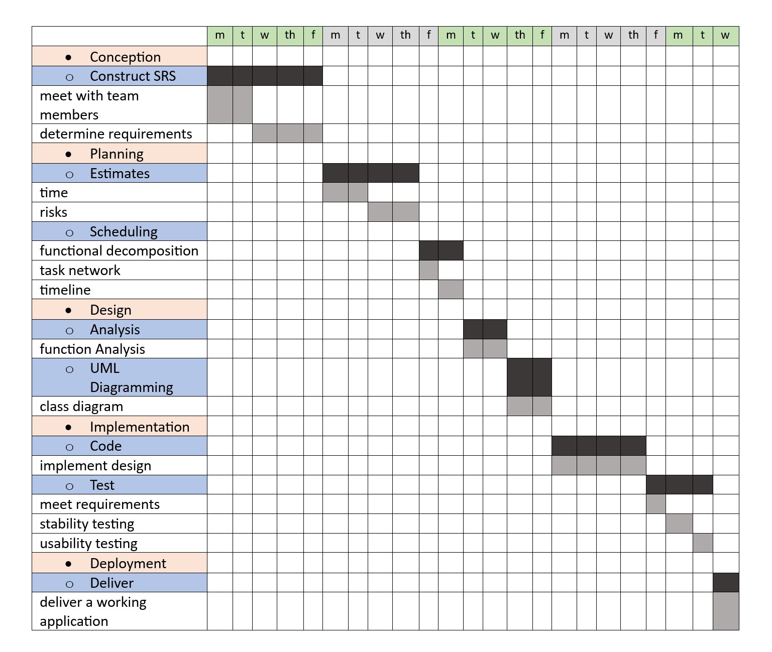
Timeline Chart for project deliverables

Slide 8
Risk Management - project risks
Unfamiliarity with different programming languages: with many of the team members having varying levels of experience in programming, there is a risk that some members will not have experience with the programming language chosen for the project.
Lack of experience with databases: some team members are not familiar with DB design and SQL programming.
Scheduling conflicts: some team members work full time along with school. Scheduling conflicts are a concern.

Slide 9
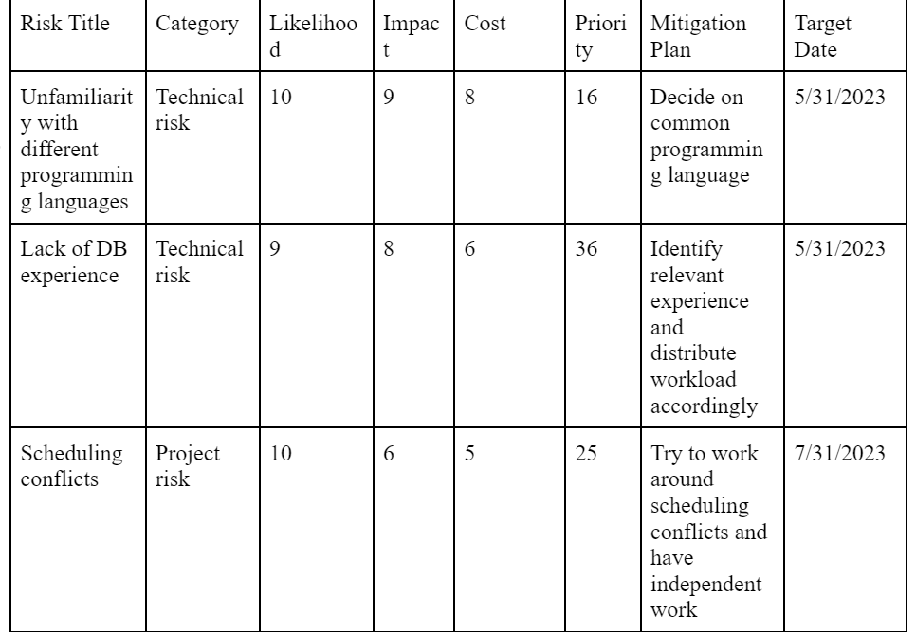
Risk Management - risk table

Slide 10
Risk Management - risk mitigation
Risk type: technical risk
Priority: 16 (11-10) * (11-9) * Cost
Risk factor: amount of programming experience by group members in chosen language
Probability: 10. The team has discussed our experience and identified that this is a risk
Impact: 9. This is a high impact risk. It can be worked around by distributing work to effectively utilize different team members experience but will be a risk throughout the project.
Monitoring approach: distribute workload and check in with team members to make sure no one feels overwhelmed by the work.
Contingency plan: by distributing the workload we can minimize the impact of this risk. All team members are capable so we can fall back on each other if necessary.
Estimated resources: a few extra days to become familiar with the code and work off of other members’ code.

Slide 11
Risk Management - risk mitigation cont.
Risk type: technical risk
Priority: 36 (11-9) * (11-6) * Cost
Risk factor: how much experience team members have with database design
Probability: 9
Impact: 8
Monitoring approach: continually check in to make sure everyone is somewhat familiar with the assigned tasks
Contingency plan: fall back on other team members in case someone is not familiar with database design/SQL
Estimated resources: a few extra days to learn about databases.

Slide 12
Risk Management - risk mitigation cont.
Risk type: project risk
Priority: 25. (11-10) * (11-6) * Cost
Risk factor: alternative commitments to jobs and other classes.
Probability: 10. Will definitely occur because we have discussed our schedules.
Impact: 6. This issue can be worked around for now. We will revisit this risk if it proves to be a problem
Monitoring approach: open line of communication to ensure team members are comfortable expressing issues in scheduling or meeting times.
Contingency plan: change around the workload if absolutely necessary. Try to have at least a few days of padding before a milestone of the project in case we run behind schedule.
Estimated resources: using the additional days of padding we reserve before a milestone and having some team members pick up work for others if necessary.

Slide 13
Project Estimates - Estimation Technique
COCOMO (Constructive Cost Model):
LOC (lines of code) : -
Calculation: 55 Data: 30
I/O: 22 Logic: 16
Setup: 15 Text: 34 55+30+16+15+34 = 15 K lines

Slide 14
Project Estimates - Estimation Technique m
Using a Semi-detached model due to the need of a database, intricate user interface and complexity of the program. By using a semi-detached model we know a = 3.0 and b = 1.12
Therefore Effort = a * (LOC) ^ b Duration = a * (Effort) ^ b
3 * (150) ^ 1.12 2.5 * (876.37) ^ 0.35
Effort = 876.37 Duration = 26.78

Slide 15
Project Estimates - Reconciled Estimate
The final cost, effort, time (duration) estimate for the project (at this point in time) is presented here.
Cost: none as we are students therefore this will not cost our professor anything.
Effort: 876.37
Time: 27 days

Slide 16
Project Estimates - Project Resources
People, hardware, software, tools, and other resources required to build the software are noted here.
People: Five CIS students with varying experience
Hardware: Personal PCs and access to lab equipment
Software: Open source software for database design, development, and testing (IDE and database management system)
Tools: Any open source software that may be needed for the project

Slide 17
Team Structure - Team structure is identified
The project is very straightforward, neither large or small, but because none of the team members are experts and it will probably take more time than it would for a group of experts. The tasks can be modularized in a logical manner, but communication among team members is a must to ensure the system functions properly as a whole. For these reasons, an agile team approach would be the best fit.

Slide 18
Roles are defined
The team is small, but highly motivated and self-organizing.
We have decided that everyone will participate in each part of the plan. This way, we learn from each other, gain knowledge in every category, and benefit from new experiences. It is also a good way to organize ourselves and have experience in each respective role. Such as : Analysis, Design, Programming, Testing and Training

Slide 19
Management Reporting and Communication
Regular Team Meetings Regular team meetings, such as weekly status meetings, provide an opportunity for each of our team members to share progress updates, discuss challenges, and align on goals. These meetings foster communication and collaboration within the team.
Progress Reports Regular progress reports provide a snapshot of project status, accomplishments, and challenges. These reports will be prepared on a weekly basis and shared with everyone to keep them informed about the project's progress.

Slide 20
Management Reporting and Communication
Communication Tools Instant messaging and communication tools, such as Microsoft Teams, E-mail, Zoom facilitate quick and efficient communication among team members. These tools help us in real-time messaging, file sharing, and the creation of dedicated channels for specific topics or project updates.
Collaborative Documentation Platforms such as Google Docs help our team to create and share project-related documents, specifications, meeting notes, and other relevant information. Collaborative documentation ensures that our team members have access to up-to-date information and fosters inter-team communication.

Slide 21
Quality assurance and control
Setting Checkpoints: Team sets the checkpoints at specified intervals for checking software’s performance, quality, and scheduling.
Measure Change Impact: For detected defects, teams will fix defects and verify whether the fix defect introduces another within the software. Teams should also check for new defects when introducing new functionalities.
Management Planning: SQA strategies should be implemented for project requirements and individuals within the team. SQA should be utilized within the project in the most efficient way.
Reports and Records: Teams should maintain all records and documents such as test cases, modifications, defect logs/fixes, requirements, and stakeholder meetings. All should be documented for future reference.

